Slide 1
The New Semantic Segmentation
Disclaimer: This presentation is a work of fiction written from the perspective of a 2020 researcher traveling back in time to mid 2013 to share some 2020 xNN based application ideas; references to credit the actual inventors of the various ideas is provided at the end
Harrison Jansma hsj180000@utdallas.edu May 1, 2020

Slide 2
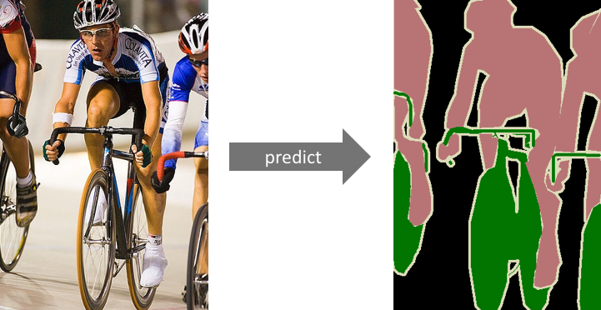
Motivation
Disclaimer: This presentation is a work of fiction written from the perspective of a 2020 researcher traveling back in time to mid 2013 to share some 2020 xNN based application ideas; references to credit the actual inventors of the various ideas is provided at the end
Involves realistic understanding of image contents. (what and where)
Medical imaging, Autonomous cars, …
Sliding window prediction
Slow implementation
Loss of localization in large windows

Slide 3
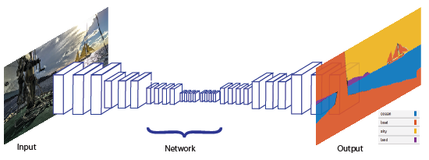
Key Insight
Disclaimer: This presentation is a work of fiction written from the perspective of a 2020 researcher traveling back in time to mid 2013 to share some 2020 xNN based application ideas; references to credit the actual inventors of the various ideas is provided at the end
Map from image -> pixel predictions
Solution needs to support:
Varied in-picture object sizes
Fast inference for applications
Fully Convolutional Network with:
Image to Image -> Arbitrary image size
Depthwise Sep Conv -> Efficient
HairNet 2: The Thinnest Prediction

Slide 4
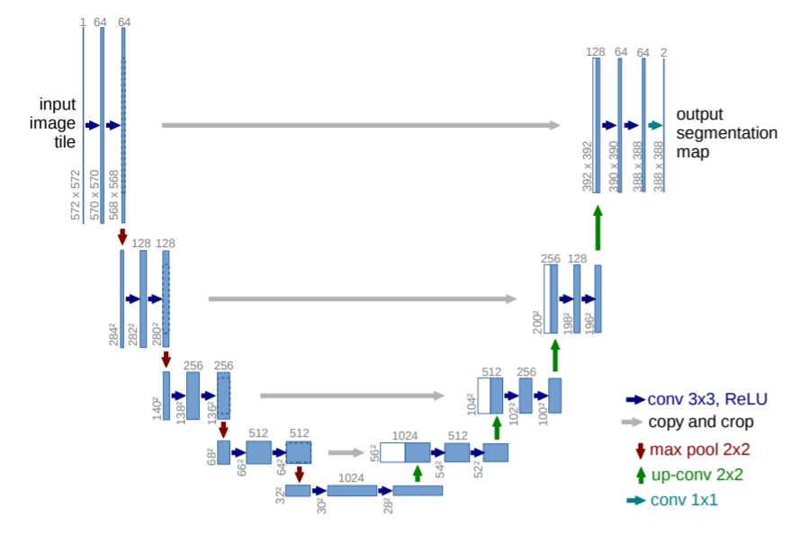
Proposed Approach
Disclaimer: This presentation is a work of fiction written from the perspective of a 2020 researcher traveling back in time to mid 2013 to share some 2020 xNN based application ideas; references to credit the actual inventors of the various ideas is provided at the end
Combine rich deep features with highly localized early network feature maps
Many features allow context to propagate during upsampling
Apply cropping and concatenation to combine early/late feature maps

Slide 5
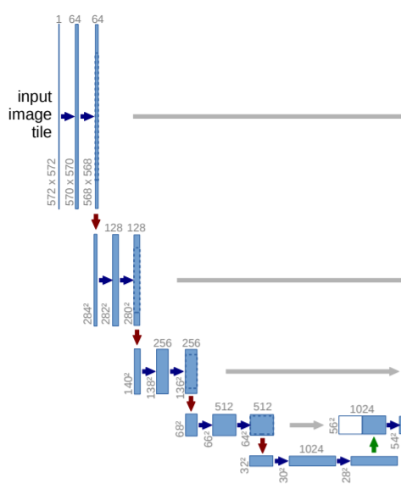
Encoder (Spatial Compression)
Disclaimer: This presentation is a work of fiction written from the perspective of a 2020 researcher traveling back in time to mid 2013 to share some 2020 xNN based application ideas; references to credit the actual inventors of the various ideas is provided at the end
Standard convolutional architecture
Series of 3x3 convolutions (or depthwise separable convolutions) followed by maxpool
Deep feature representations learn WHAT is in a segment of an image.
Lose info on WHERE object is in segment

Slide 6
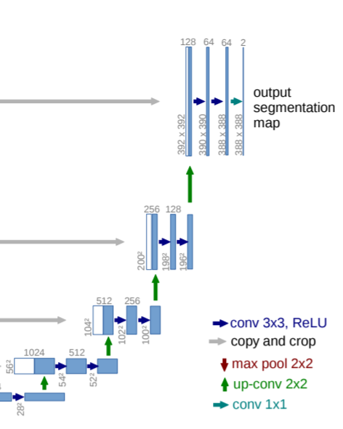
Decoder (Spatial Expansion)
Disclaimer: This presentation is a work of fiction written from the perspective of a 2020 researcher traveling back in time to mid 2013 to share some 2020 xNN based application ideas; references to credit the actual inventors of the various ideas is provided at the end
“up-convolution” halves number of feature dims and expands height/width
Concatenate cropped feature maps from earlier stage in the network
Follow with a series of 3x3 convolutions
Final layer uses 1x1 conv to map channel dim to number of classes

Slide 7
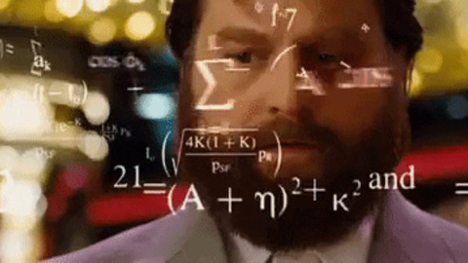
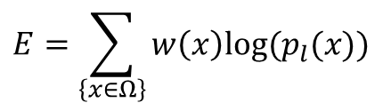
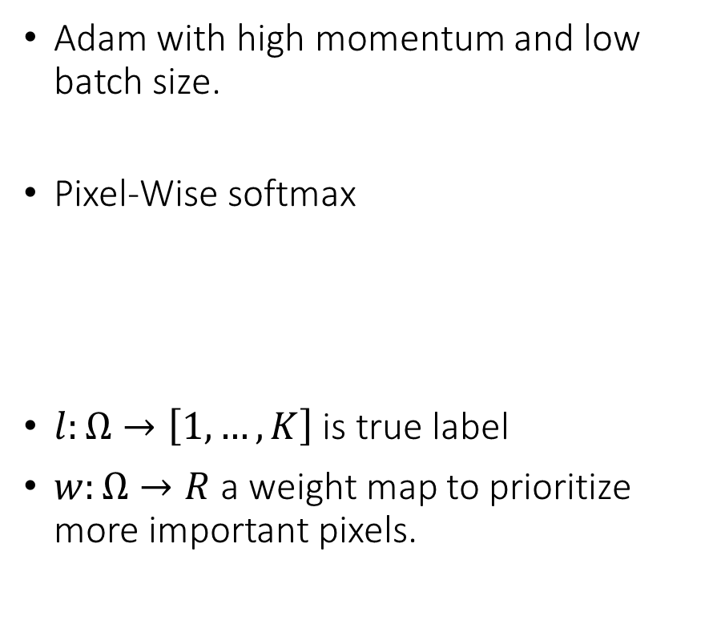
Training Methods
Disclaimer: This presentation is a work of fiction written from the perspective of a 2020 researcher traveling back in time to mid 2013 to share some 2020 xNN based application ideas; references to credit the actual inventors of the various ideas is provided at the end
Adam with high momentum and low batch size.
Pixel-Wise softmax
$l:Ω→\left[1,…,K\right]$ is true label
$w:Ω→R$ a weight map to prioritize more important pixels.
$$E=\sum_{\left\{x∈Ω\right\}}{w\left(x\right)log⁡(p_{l}(x))}$$

Slide 8
Results
Disclaimer: This presentation is a work of fiction written from the perspective of a 2020 researcher traveling back in time to mid 2013 to share some 2020 xNN based application ideas; references to credit the actual inventors of the various ideas is provided at the end
Here’s where you include the demo results
Add a link to your GitHub or Colab code
Include some of the main details of how the results were generated
Add some commentary pointing out key positive and negative aspects
Nice to include a relevant picture here

Slide 9

Next Steps
Disclaimer: This presentation is a work of fiction written from the perspective of a 2020 researcher traveling back in time to mid 2013 to share some 2020 xNN based application ideas; references to credit the actual inventors of the various ideas is provided at the end
Some ideas for future experimentation
Residual connections with addition instead of concatenations
Multiple convolutional filters with different sizes.
Further experimentation with methods to reduce memory footprint.
Bottleneck layers

Slide 10
References
Disclaimer: This presentation is a work of fiction written from the perspective of a 2020 researcher traveling back in time to mid 2013 to share some 2020 xNN based application ideas; references to credit the actual inventors of the various ideas is provided at the end
Note: As stated above, this presentation is a work of fiction; the following are the actual inventors of the ideas described in this presentation
O. Ronneberger, et. al., “, U-Net: Convolutional Networks for Biomedical Image Segmentation” arXiv:1505.04597, 2015.
https://github.com/qubvel/segmentation_models

Slide 11
Thank You!
Disclaimer: This presentation is a work of fiction written from the perspective of a 2020 researcher traveling back in time to mid 2013 to share some 2020 xNN based application ideas; references to credit the actual inventors of the various ideas is provided at the end

